Slide 1
Log File Analysis
Software System Development — Monsoon 2024
Guided By – Prof. Sai Anirudh Karre
Made By
- Shubham Dewangan (2024202005)
- Lakshay Baijal (2024202006)
- Vanshika Singh (2024202008)
- Aryan Prajapati (2024202009)

Slide 2
What is Log Analysis?
Log Analysis is the process of reviewing, interpreting, and extracting meaningful information from log files generated by systems, applications,
and devices.
Purpose:
Monitor system performance
Detect security breaches
Troubleshoot issues
Ensure compliance
Operational Efficiency

Slide 3
Common Types of Logs
Operating Systems: Windows, Linux, macOS,SolarisOS.
System Logs: Capture operating system events (e.g., Windows Event Logs, Syslog).
Application Logs: Record application-specific events (e.g., error messages).
Security Logs: Track security-related events (e.g., login attempts, firewall activities).
Network Logs: Monitor network traffic and activities (e.g., router logs, IDS/IPS logs).

Slide 4
Log Analysis Process
Overview of Log Analysis Process
Log Collection
Log Storage
Log Parsing
Log Correlation
Log Visualization and Reporting

Slide 5
implementation

Slide 6
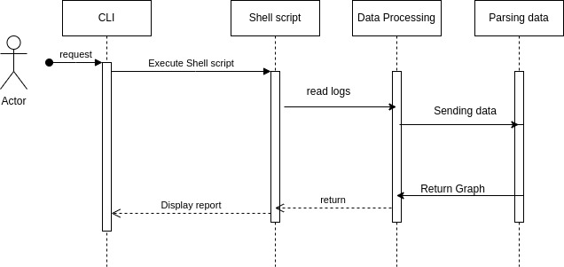
Sequence diagram

Slide 7
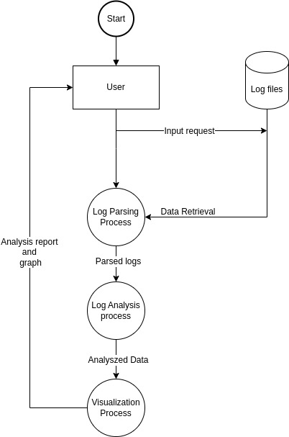
Data flow diagram

Slide 8
LOG File samples

Slide 9
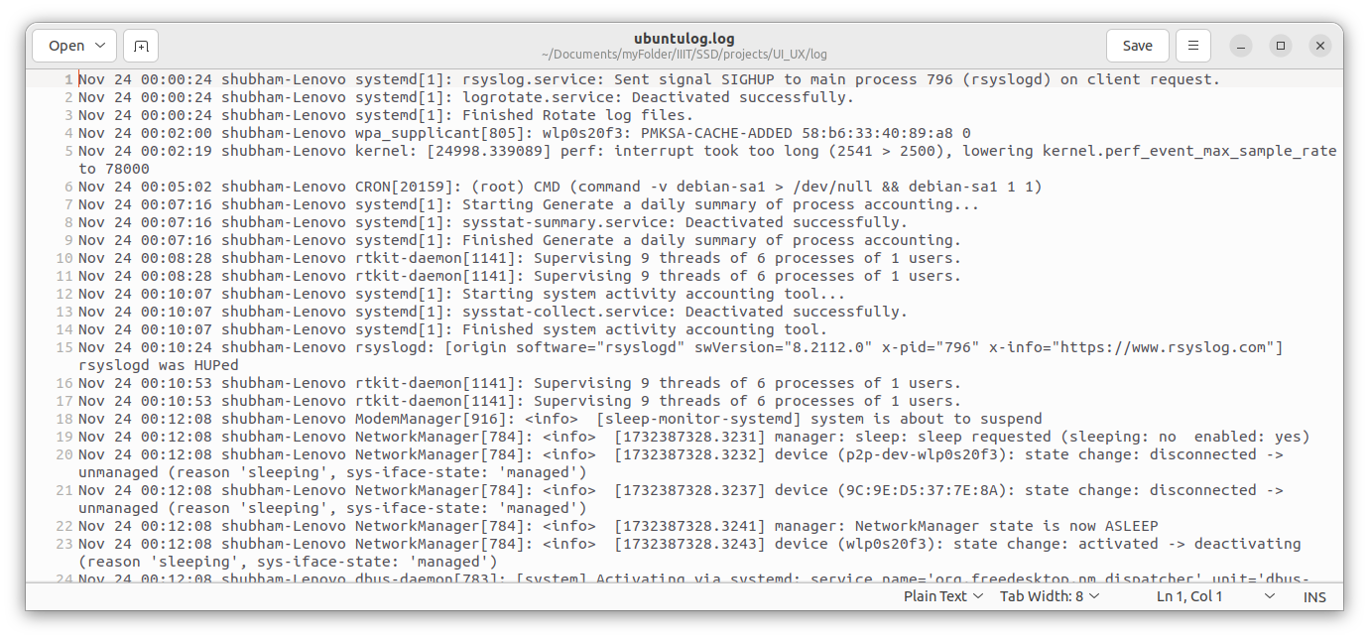
Ubuntu syslog

Slide 10
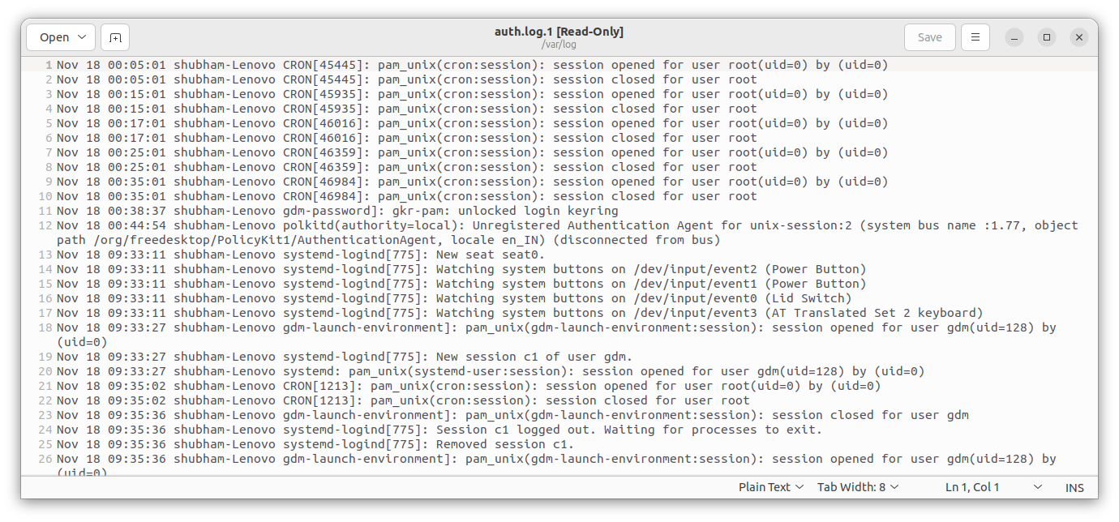
Ubuntu auth log

Slide 11
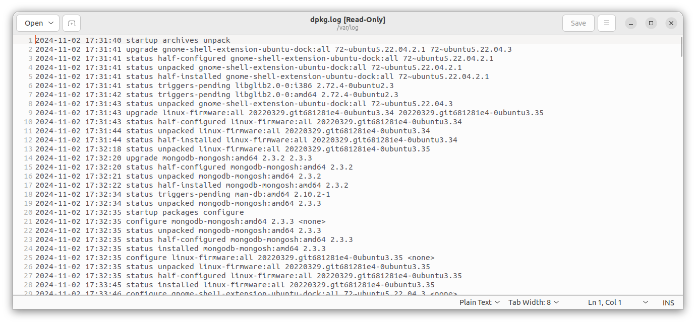
Ubuntu package manager log

Slide 12
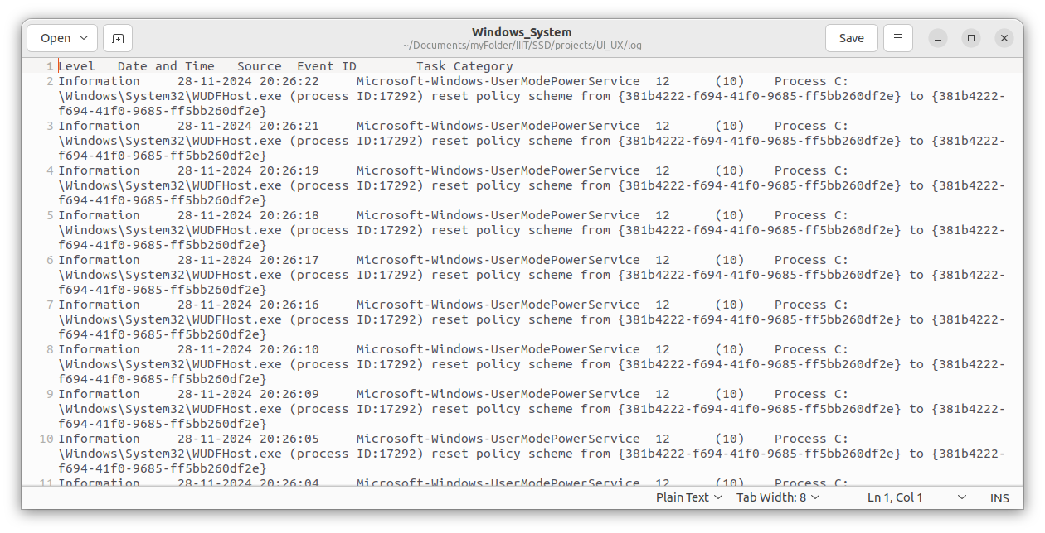
Windows system log

Slide 13
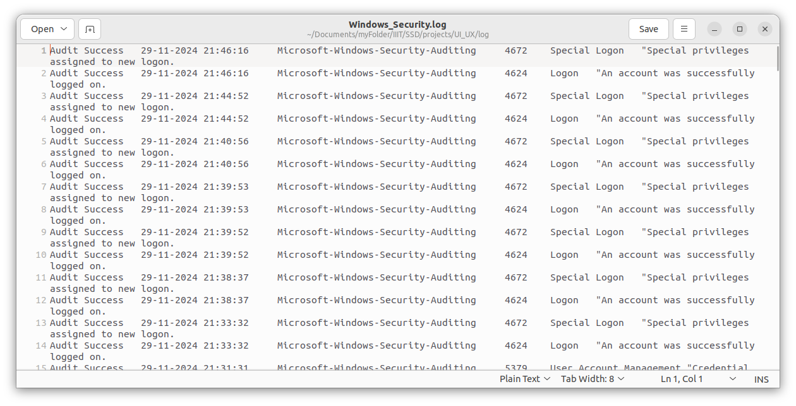
Windows security log

Slide 14
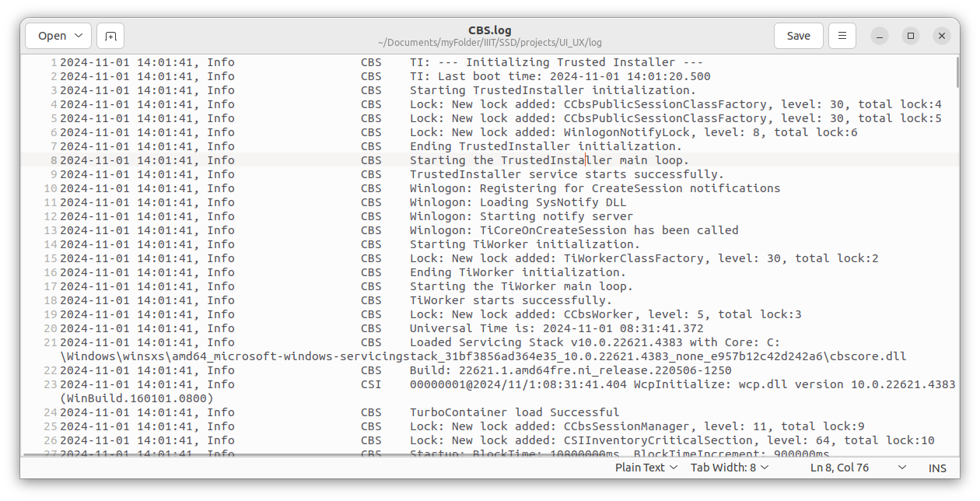
cbs log

Slide 15
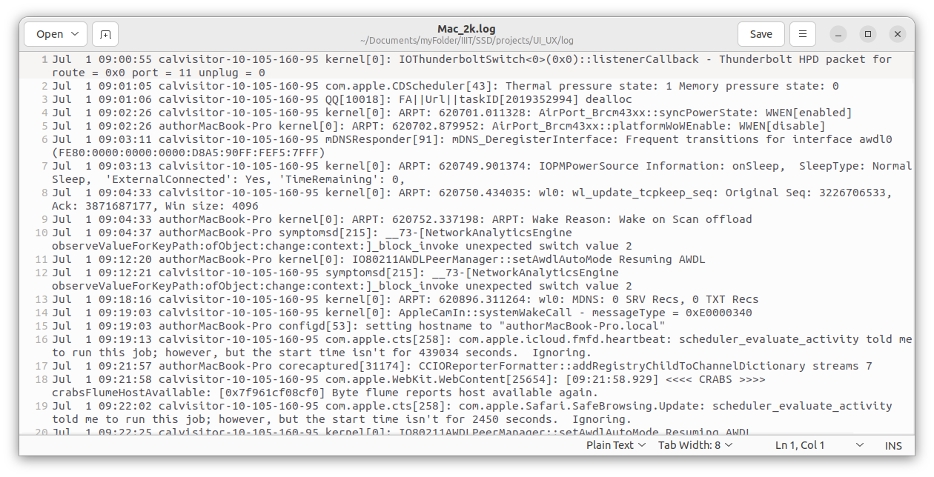
Mac system log

Slide 16
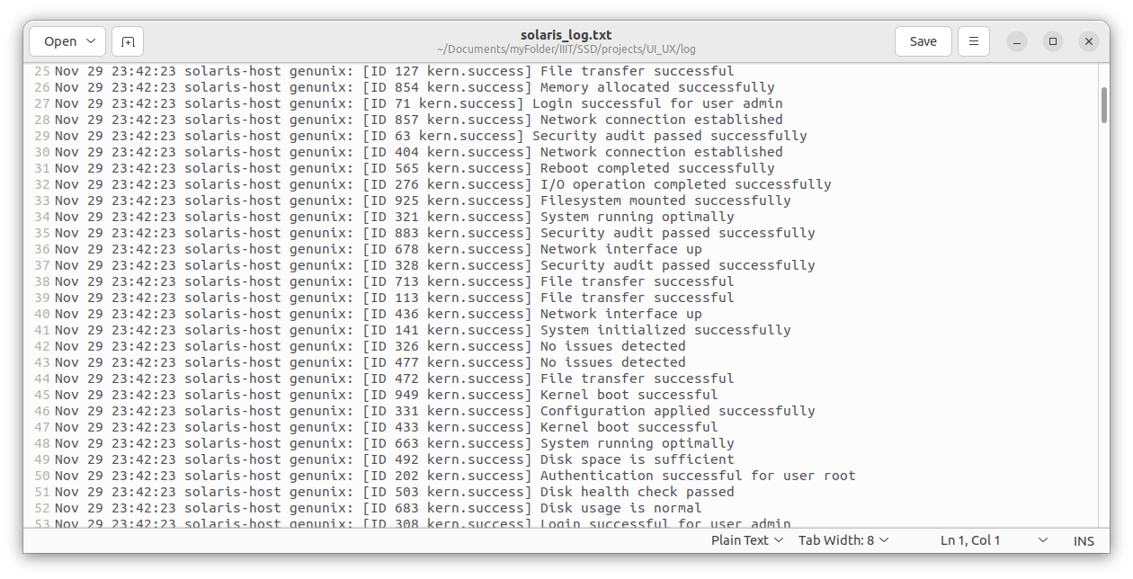
Solaris sample log

Slide 17
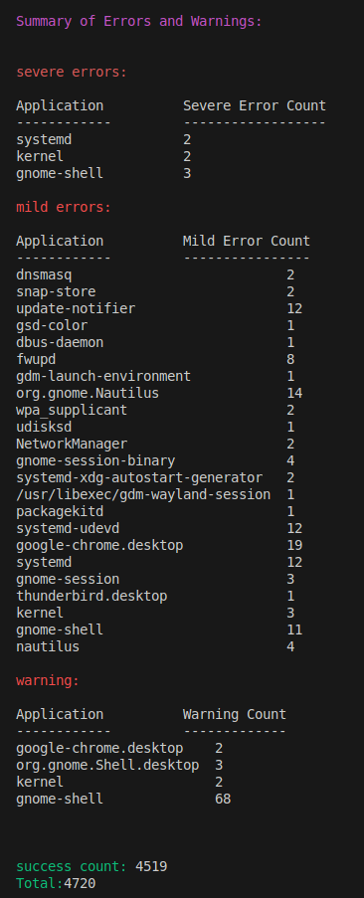
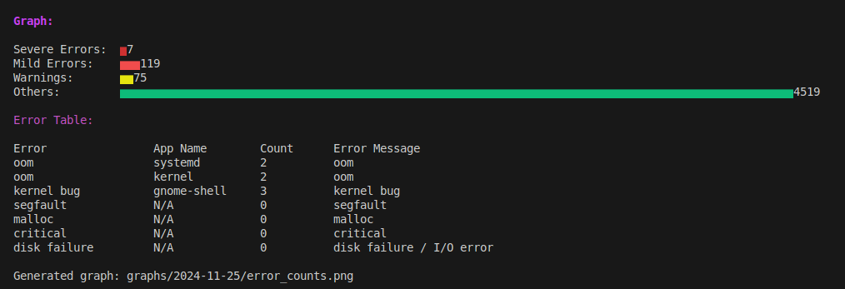
Ubuntu Memory Analysis

Slide 18
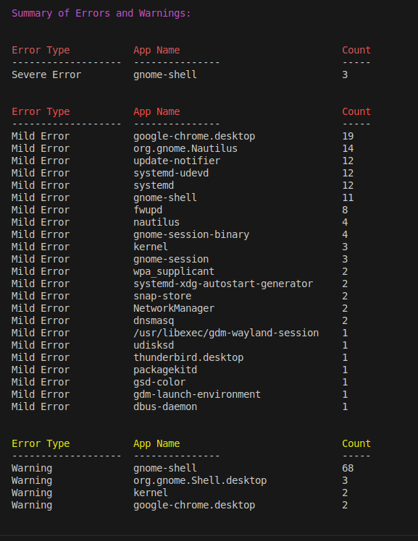
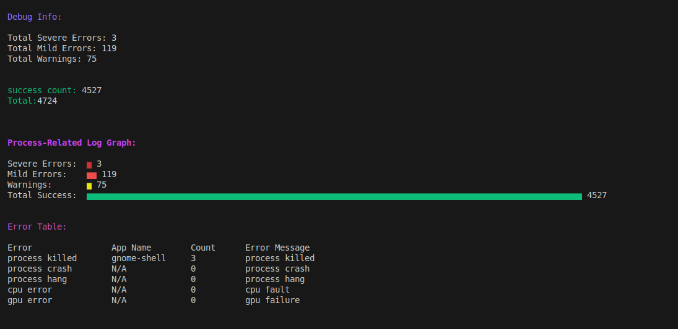
Ubuntu Process

Slide 19
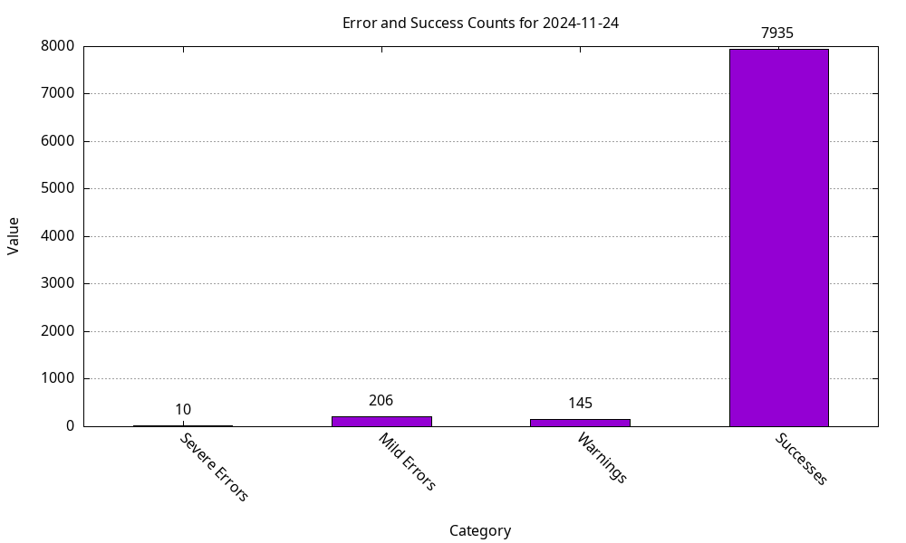
Error and Success counts

Slide 20
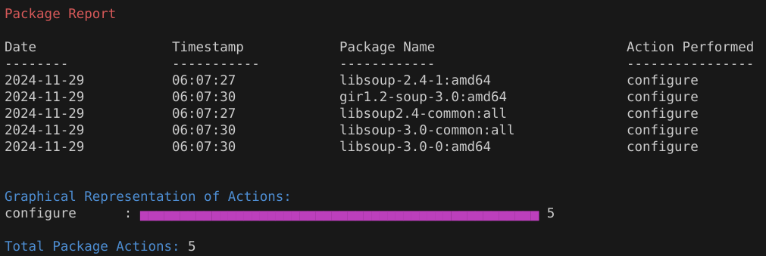
Ubuntu package Manager

Slide 21
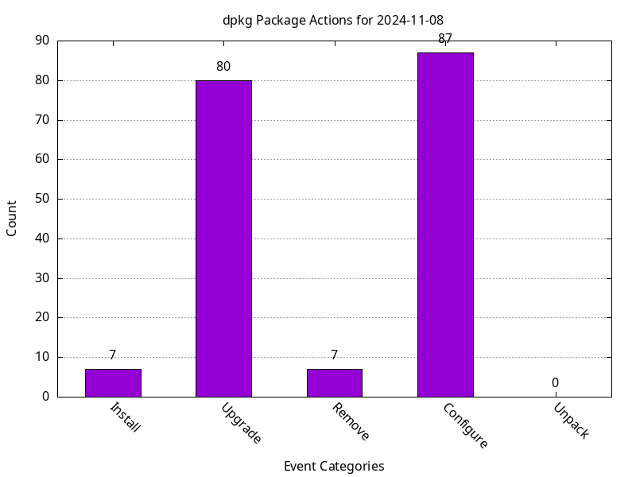
Ubuntu – package manager

Slide 22
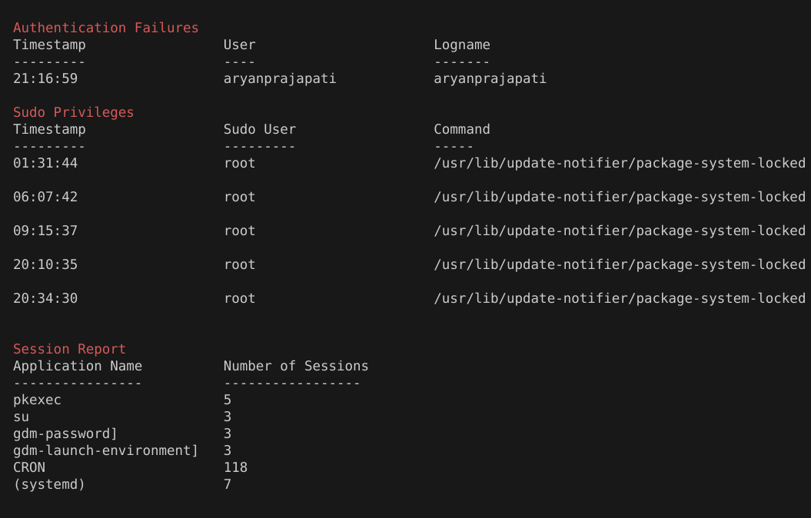
Ubuntu - authenticate

Slide 23
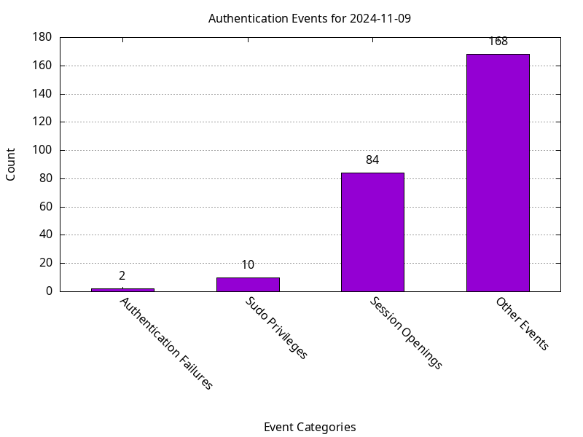
Ubuntu - Authenticate

Slide 24
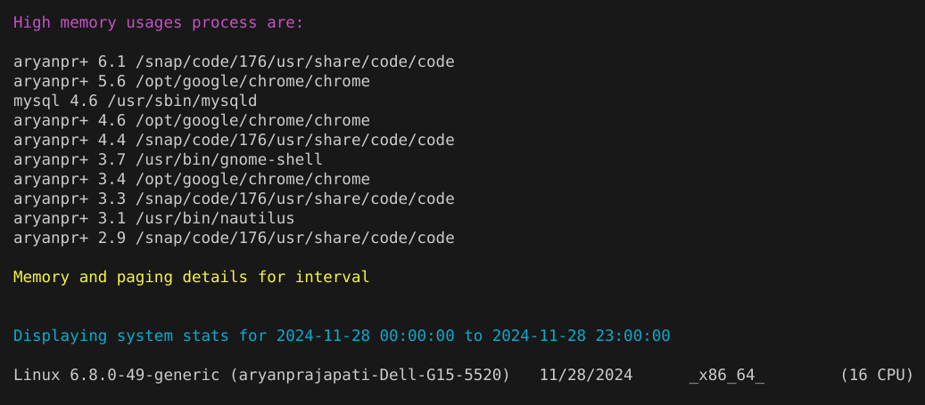
Ubuntu – quick system status

Slide 25
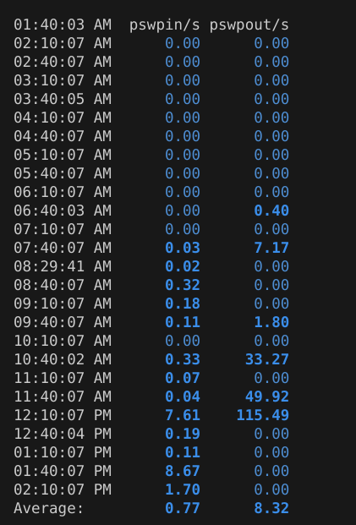
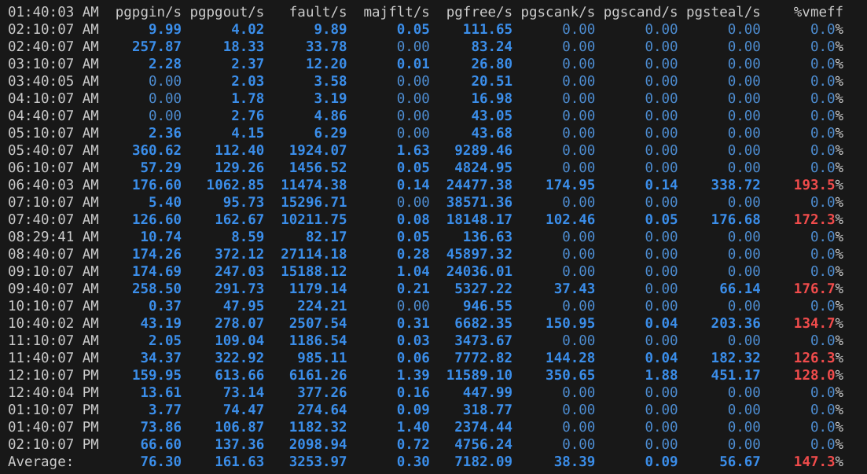
Ubuntu – quick system status

Slide 26
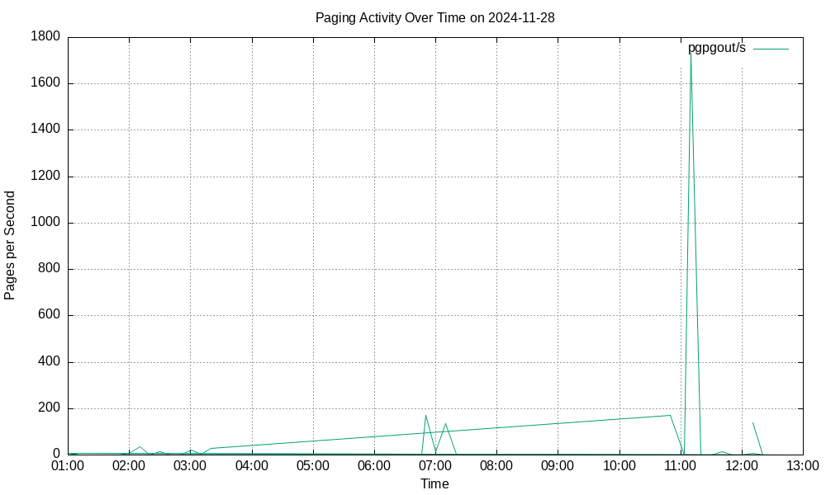
Ubuntu – quick system status

Slide 27
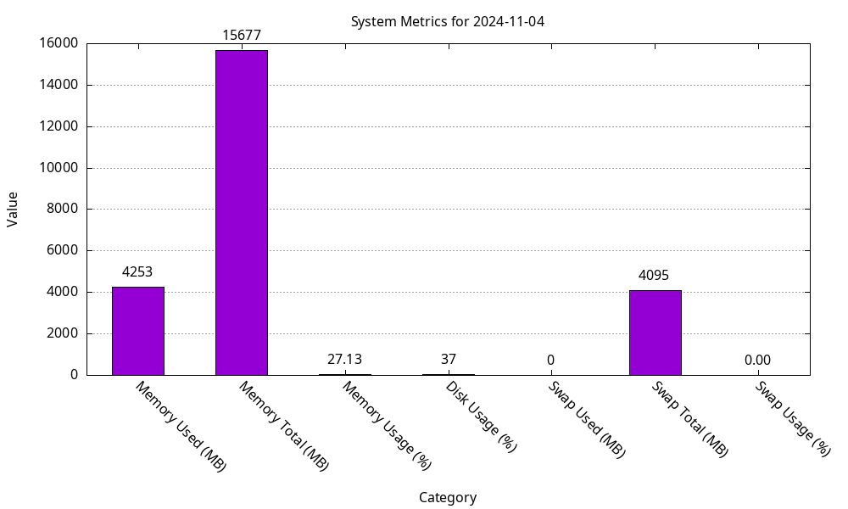
Ubuntu – quick system status

Slide 28
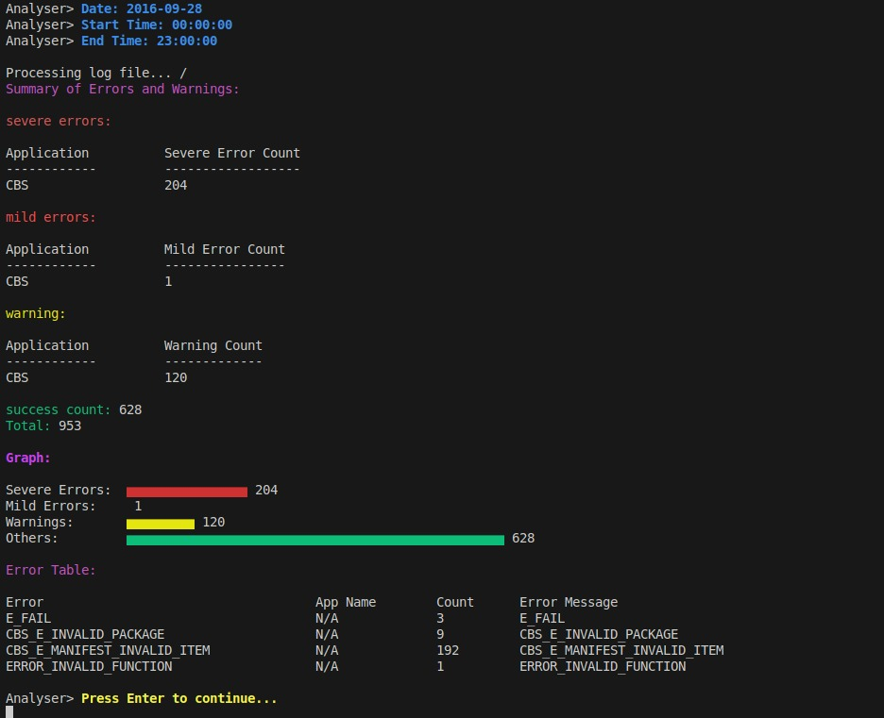
Windows – cbs

Slide 29
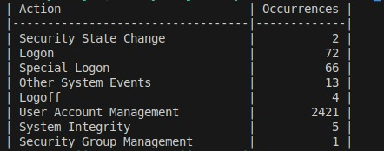
Windows – security

Slide 30
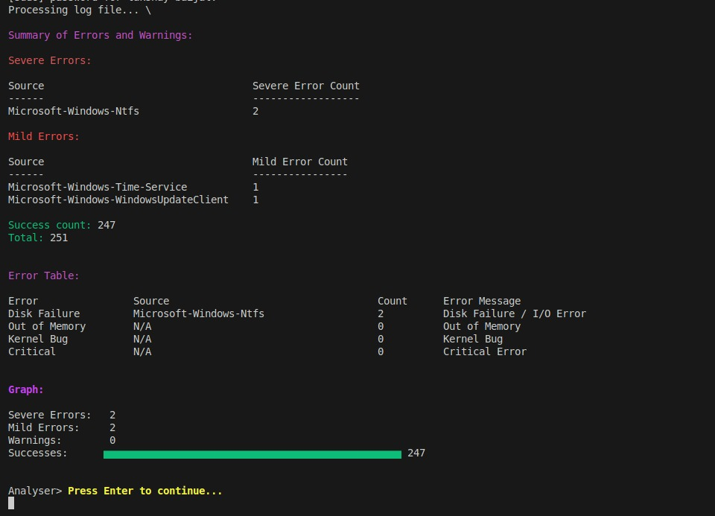
windows - system

Slide 31
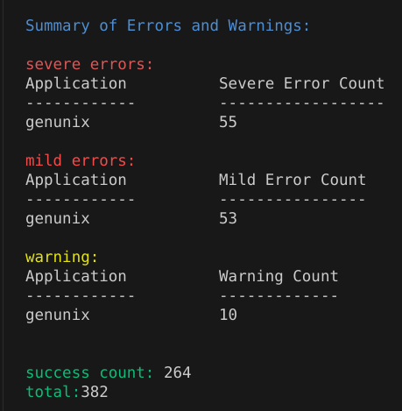
Solaris – analysis result

Slide 32
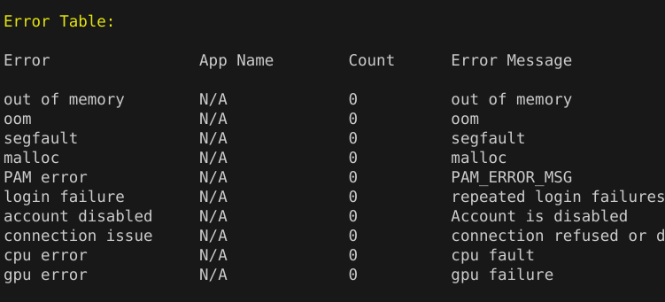
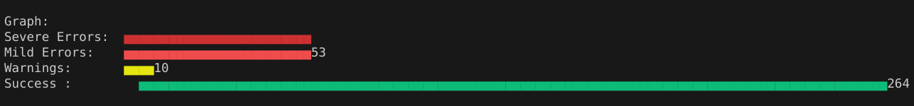
Solaris – analysis result

Slide 33
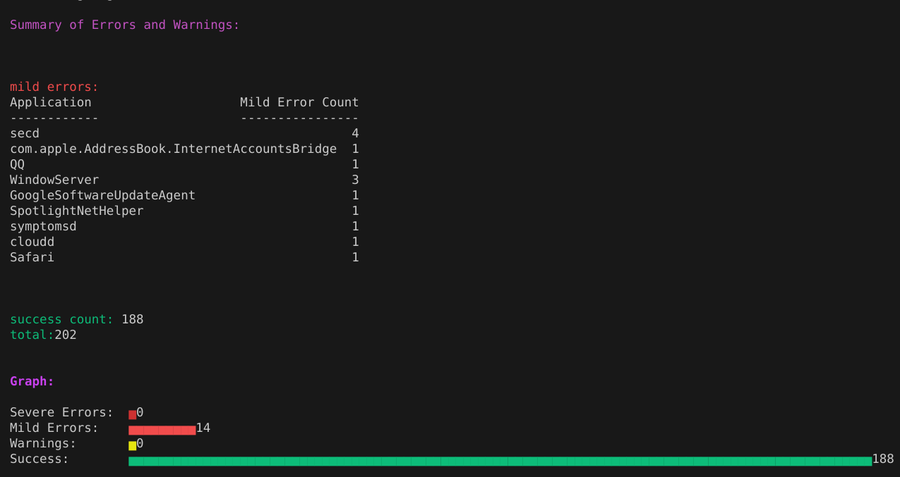
Mac – analysis result

